Slide 1
Conceptual Models & Interface Metaphors
November 8, 2017
Notes:
Took 15 minute team break 55 min in (started 7 min late)
Quiz took a little longer as had tech problems
Finished 3 min late and had to skip summary/next time slides

Slide 2

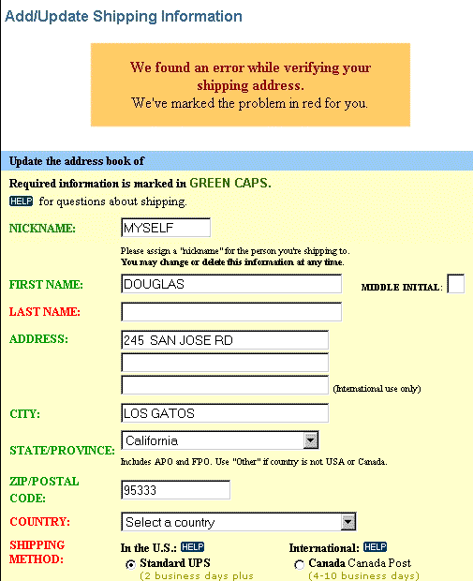
Hall of Fame or Shame?
Design based on a top retailer’s site

Slide 3

Hall of Shame!
Design based on a top retailer’s site
Color deficiency
can’t distinguish between red & green
In study, user could not get by this screen!
How to fix?
redundant cues

Slide 4
Hall of Fame or Shame?
M-Pesa mobile payments
Common in Africa
http://africanbusinessmagazine.com/wordpress/wp-content/uploads/2014/07/mobile-payment.png
http://blog.unibulmerchantservices.com/m-pesa-by-the-numbers/
Notes:
64% of Nigerians do not have a bank account
Over 80% have a mobile phone

Slide 5
Hall of Fame or Shame?
M-Pesa mobile payments
Common in Africa
http://africanbusinessmagazine.com/wordpress/wp-content/uploads/2014/07/mobile-payment.png
Notes:
64% of Nigerians do not have a bank account
Over 80% have a mobile phone

Slide 6

Hall of Fame!
M-Pesa mobile payments
Common in Africa
Simple UI, but brings banking services to the unbanked!
http://africanbusinessmagazine.com/wordpress/wp-content/uploads/2014/07/mobile-payment.png
http://blog.unibulmerchantservices.com/m-pesa-by-the-numbers/
Notes:
64% of Nigerians do not have a bank account
Over 80% have a mobile phone

Slide 7
Conceptual Models & Interface Metaphors
November 8, 2017
Notes:
took 10 minute team break at 2:44 (59 minutes in)

Slide 8
Outline
Design of Everyday Things
Conceptual models
Team break
Interface metaphors
UI consistency

Slide 9
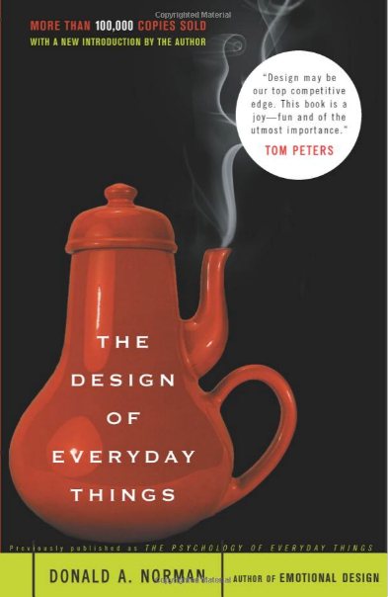
Design of Everyday Things
By Don Norman (UCSD, Apple, HP, NN Group, NU, UCSD)
Design of everyday objects illustrates problems faced by designers of systems
Explains conceptual models
doors, washing machines, digital watches, telephones, ...
Resulting design guides
→ Highly recommended
Notes:
This lecture tries to give some of the high level ideas in this book (and the 1st chapter you read gives a taste)

Slide 10
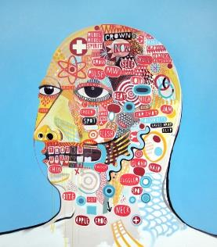
Conceptual Model?
Mental representation of how an artifact works & how interface controls affect it
People may have preconceived models that are hard to change
(4 + 5) vs. (4 5 +)
dragging to trash?
deletes file but ejects disk
Interface must communicate model
visually (& possibly physically or using sound)
David Shillinglaw
Notes:
Also sometimes called a “Mental Model”
Shouldn’t need online help or documentation to communicate the model

Slide 11
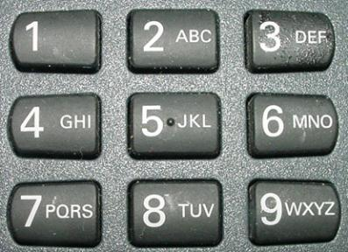

Affordances as Perceptual Clues
Well-designed objects have affordances
clues to their operation
often visual, but not always (e.g., speech)
iOS7
iOS7 w/ “button shapes” accessibility
iOS6
What affordances do you see here?
Notes:
In DOET, affordances are visual. But affordances are more than that. Affordances can be physical or audio
Buttons in IOS… IOS7, iOS7 with “button shapes” accessibility turned on, and iOS6 (from http://blog.teamtreehouse.com/affordances-web-design)
People have now learned it, but still

Slide 12
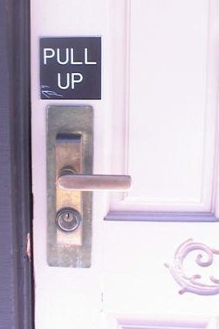
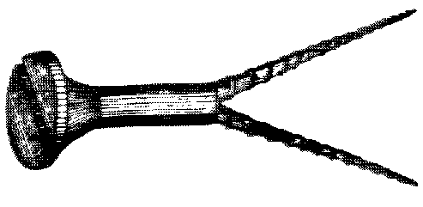
Affordances as Perceptual Clues
Poorly-designed objects
no clues or misleading clues
French artist Jacques Carelman
Crazy design for a screw punch!
Notes:
misleading

Slide 13
Affordances as Perceptual Clues
Poorly-designed objects
no clues or misleading clues
http://alistapart.com/article/flat-ui-and-forms
Notes:
What is wrong here?
[ADVANCE]
See how this second one makes it a bit more clear you should type in the box?
[ADVANCE]
See how this last one is even better. The white & the box make it clear what to do.

Slide 14
Refrigerator
freezer
fresh food
Problem: freezer too cold, but fresh food just right

Slide 15
Refrigerator Controls
Normal Settings C and 5
Colder Fresh Food C and 6-7
Coldest Fresh Food B and 8-9
Colder Freezer D and 7-8
Warmer Fresh Food C and 4-1
OFF (both) 0
A B C D E
7 6 5 4 3 2 1
What is your conceptual model?
Spend 30 sec. drawing a diagram showing your model (where the cooling units are & how controlled)
Share with your neighbor
Notes:
Take 30 seconds to draw it & then share with your neighbor

Slide 16
A Common Conceptual Model
A B C D E
cooling
unit
7 6 5 4 3 2 1
cooling
unit
independent cooling units

Slide 17
Actual Conceptual Model
A B C D E
cooling
unit
7 6 5 4 3 2 1
Can you fix the problem?
Possible solutions
make controls map to customer’s model
make controls map to actual system

Slide 18
Design Model & Customer Model
Design Model
Customer Model
System Image
Customers get model from experience & usage
through system image
What if the two models don’t match?

Slide 19
Conceptual Model Mismatch
Mismatch between designer’s & customer’s conceptual models leads to…
slow performance
errors
frustration
...

Slide 20
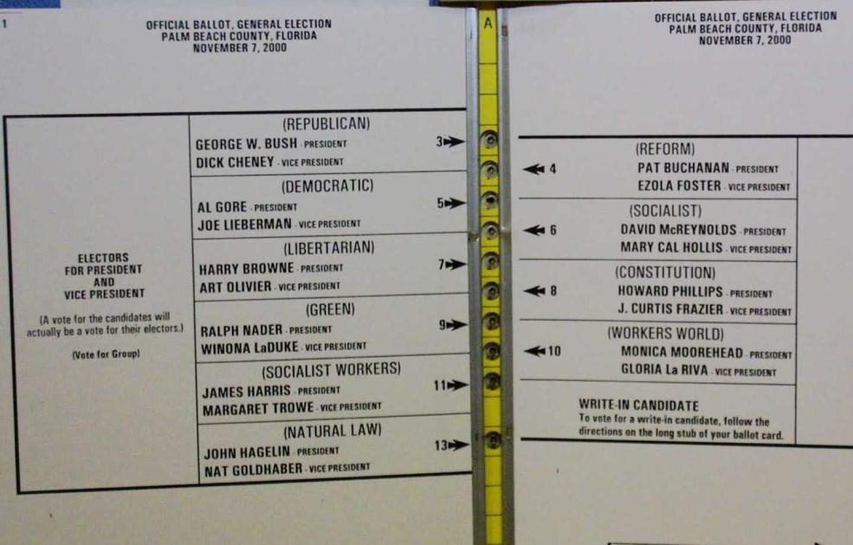
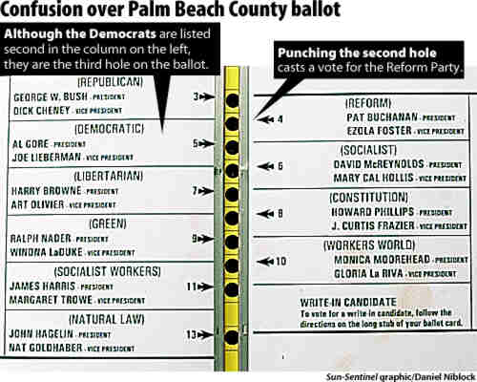
Notorious Example
Notes:
2000 Presidential Election. Palm Beach Florida

Slide 21
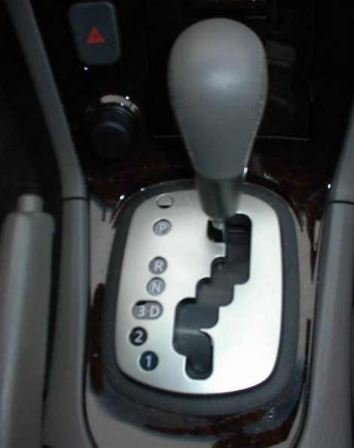
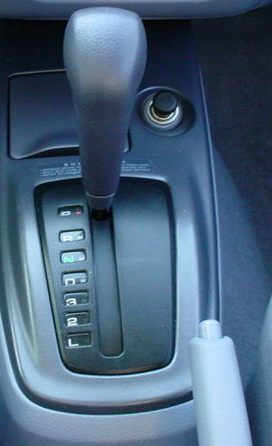
Car Automatic Shifter
Notes:
Image at left seems obvious, but many first time users of this design don’t notice the difference between “3 and D” and in fact put the car in third gear when they mean to put it in Drive.
The more standard gear shift distinguishes these more directly.
On the other hand, the newer design has a more PHYSICAL feedback

Slide 22
Design Guides
Provide good conceptual model
customer wants to understand how controls affect object
Make things visible
if object has function, interface should show it
Map interface controls to customer’s model
infix vs. postfix calculator – whose model is that?
Provide feedback
what you see is what you get! (WYSIWYG)
Notes:
Let’s talk about each of these in more detail

Slide 23
Make Things Visible
Refrigerator (?)
make the A..E dial something about percentage of cooling between the two compartments?
Controls available on watch w/ 3 buttons?
too many and they are not visible!

Slide 24
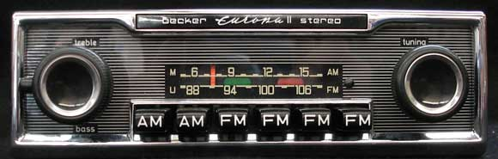
Make Things Visible
Compare to controls on old car radio
#controls = #functions
controls are labeled (?) and grouped together
tradeoffs of the “glass UI” (e.g., Tesla)?
Notes:
Where the term ”radio button” comes from
http://www.brucesallan.com/wp-content/uploads/2013/03/Becker-Car-Stereo.jpg

Slide 25
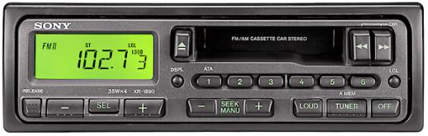
Make Things Visible
Compare to controls on old car radio
#controls = #functions
controls are labeled (?) and grouped together
tradeoffs of the “glass UI” (e.g., Tesla)?

Slide 26
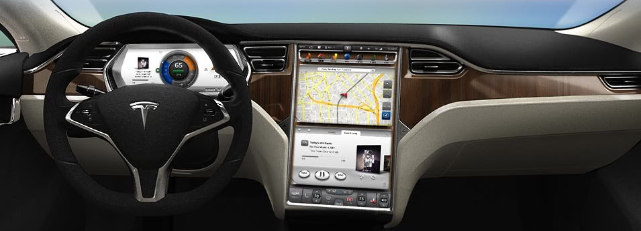
Make Things Visible
Compare to controls on old car radio
#controls = #functions
controls are labeled (?) and grouped together
tradeoffs of the “glass UI” (e.g., Tesla)?

Slide 27
Map Interface Controls to Customer’s Model
Which is better for car dashboard speaker front / back control?
Control should mirror real-world
Dashboard
1
2

Slide 28
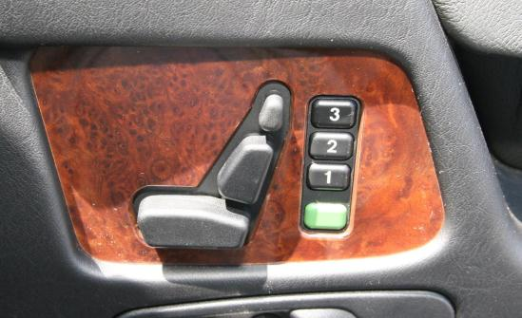
Map Interface Controls to Customer’s Model
Which is better for car dashboard speaker front / back control?
Control should mirror real-world
Mercedes Benz Seat Control

Slide 29
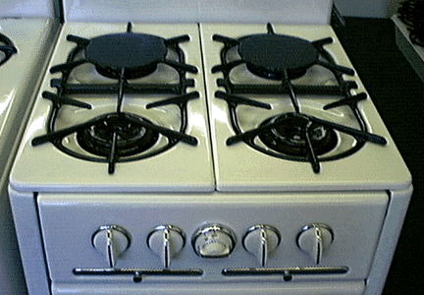
Map Interface Controls to Customer’s Model
Problem?
Which knob controls which burner?

Slide 30
Map Interface Controls to Customer’s Model
Possible fixes?

Slide 31
Metaphor
Definition ?
“The transference of the relation between one set of objects to another set for the purpose of brief explanation.”
Lakoff & Johnson, Metaphors We Live By
“...the way we think, what we experience, and what we do every day is very much a matter of metaphor.”
in our language & thinking – “argument is war”
… he attacked every weak point
… criticisms right on target
… if you use that strategy
We can use metaphor in interface design to leverage existing conceptual models

Slide 32
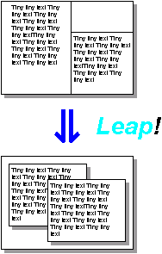
Desktop Metaphor
Suggests a conceptual model
not really an attempt to simulate a real desktop
a way to explain why some windows overlapped
leverages existing knowledge about files, folders & trash
Notes:
The first image is the windows as invented by Engelbart
When you push a metaphor TOO far is when it gets interesting

Slide 33
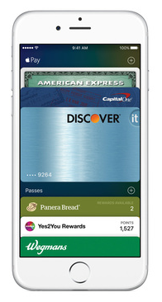
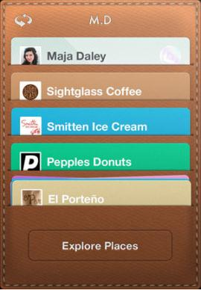
Example Metaphors
Global metaphors
personal assistant, wallet, clothing, pens, cards, telephone, eyeglasses
Data & function
rolodex, to-do list, calendar, applications documents, find, assist
Collections
drawers, files, books, newspapers, photo albums
Square Card Case

Slide 34
How to Use Metaphor
Develop interface metaphor tied to conceptual model
Communicate that metaphor to the user
Provide high-level task-oriented operations, not low-level implementation commands
Notes:
34
Develop interface metaphor or conceptual model
Communicate that metaphor to the user
Provide high-level task-oriented operations not low-level implementation commands

Slide 35

Metaphor for Metaphor’s Sake
Skeuomorphism:
“making items resemble their real-world counterparts” or “a physical ornament or design on an object made to resemble another material or technique”
Argument against: takes up space & leads to inconsistent look
Argument for: helps people learn
Apple iBooks2
Notes:
35
Pushback on use of metaphor. If it doesn’t help, why have it?
http://blog.tmcnet.com/blog/rich-tehrani/assets_c/2012/01/ibooks-thumb-500x717-10426.png
Why bad? Why good?
Skeuomorphism is the design concept of making items represented resemble their real-world counterparts. Skeuomorphism is commonly used in many design fields, including user interface (UI) and Web design, architecture, ceramics and interior design.
The shutter-click sound emitted by most camera phones when taking a picture is an auditory skeuomorph: it does not come from a mechanical shutter, which camera phones lack, but from a sound file in the phone's operating system.

Slide 36
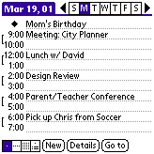
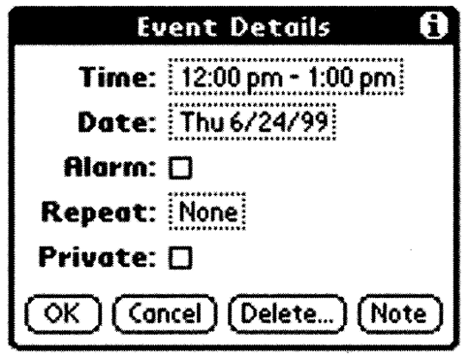
Is Consistent Always Better?
NO
Palm PDA example: should “new appointment” & “delete appointment” be in the same place?
New (add) is common, but delete is not
Notes:
Consistency of having add/delete together always, vs. making it faster for common task

Slide 37
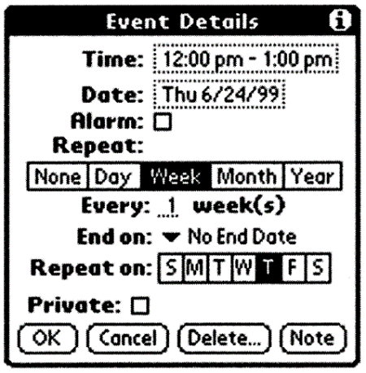

Is Consistent Always Better?
NO
Early Palm design
(like desktop version)
Streamlined design
Notes:
Consistency with desktop (early design) vs. making it better for mobile

Slide 38
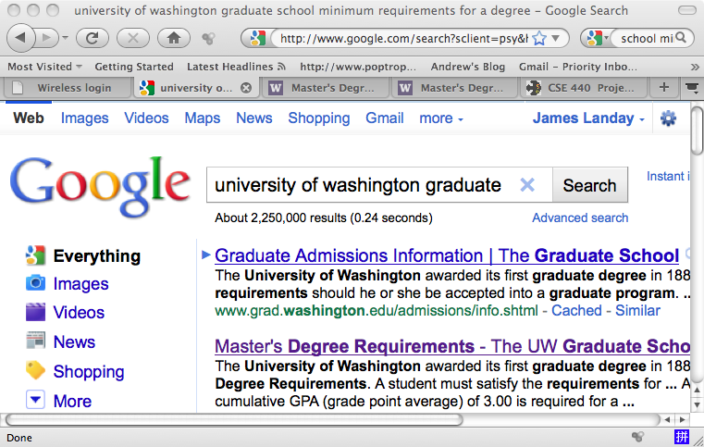
Is Consistent Always Better?
NO
Firefox 3 Back/Forward Buttons

Slide 39
Ways of Being Consistent
Interfaces should be consistent in a meaningful way
e.g., ubiquitous use of same keys for cut/copy/paste
Types of consistency
consistent internally
e.g., same terminology and layout throughout app
consistent with other apps
ex. works like MS Word, uses keyboard conventions
design patterns (across many apps)
consistent with physical world

Slide 40

Summary
Conceptual models ?
mental representation of how the object works & how interface controls effect it
Design model should equal customer’s model ?
mismatches lead to errors
use customer’s likely conceptual model to design
Design guides ?
make things visible
map interface controls to customer’s model
provide feedback
Design Model
Customer Model
System Image

Slide 41
Further Reading
Design of Everyday Things, Donald Norman
Design as Practiced, Donald Norman
Talks about failure to make changes to Macintosh
http://www.jnd.org/dn.mss/Design_as_Practiced.html
Computing the Case Against User Interface Consistency, Jonathan Grudin
Talks about why interfaces should not always be consistent
http://citeseerx.ist.psu.edu/viewdoc/download?doi=10.1.1.90.6480&rep=rep1&type=pdf

